Slide 1


Security Measures in IT
Start here
Prepared by : Sadikshya chhetri
Ankita Baral
Rohan shrestha

Slide 2

Introduction
In this presentation, we will explore essential security tools such as firewalls, proxies, and VPNs, alongside various security threats to hosts, networks, and applications. Additionally, we will discuss countermeasures and design guidelines for securing web applications.

Slide 3

Security Tools
01

Slide 4
Firewalls Overview
Firewalls are critical components of network security, acting as barriers between trusted internal networks and untrusted external networks. They monitor and control incoming and outgoing network traffic based on predetermined security rules, thereby preventing unauthorized access and threats.

Slide 5
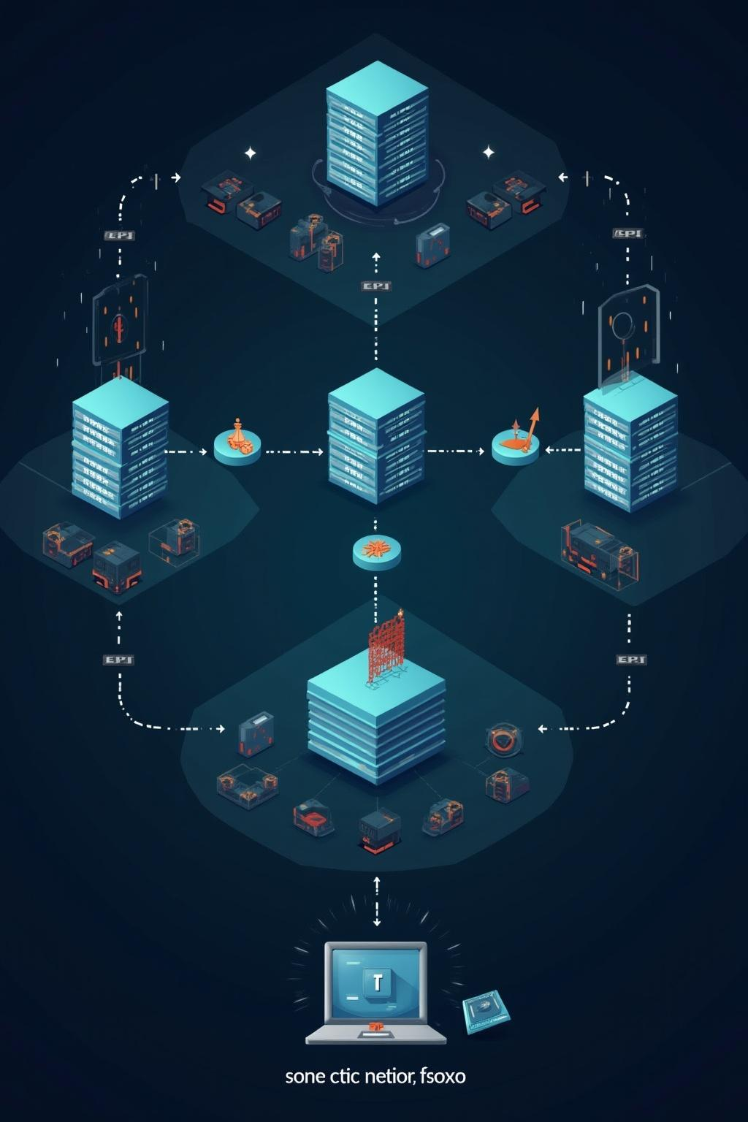
Proxy Servers Functions
Proxy servers serve as intermediaries between clients and servers. They can enhance security by hiding the client's IP address and filtering requests and responses. Additionally, proxies can cache content to improve performance and maintain anonymity, making it difficult for attackers to trace user activities.

Slide 6
Virtual Private Networks (VPNs)
Virtual Private Networks (VPNs) provide a secure and encrypted connection over a less secure network, such as the internet. They hide the user's IP address and encrypt all data transmitted between the user and the VPN server, ensuring privacy and confidentiality. VPNs are widely used for remote access to corporate networks and secure communication for users working from various locations.

Slide 7

Threats & Countermeasures
02

Slide 8
Host Security Threats
Host security threats target individual computers and devices, exploiting vulnerabilities to gain unauthorized access or control. Common threats include malware, ransomware, and insider attacks. Implementing robust antivirus solutions, regular software updates, and access controls can mitigate these risks and enhance overall host security.

Slide 9

Network Security Threats
Network security threats compromise the integrity and availability of networks. These threats include denial-of-service (DoS) attacks, man-in-the-middle (MitM) attacks, and unauthorized access through weak points in the network infrastructure. Implementing firewalls, intrusion detection systems, and secure network configurations are essential countermeasures against these threats.

Slide 10
Application Security Threats
Application security threats aim to exploit vulnerabilities within software applications. Common risks include SQL injection, cross-site scripting (XSS), and data breaches. To counter these threats, developers should adopt secure coding practices, conduct regular security assessments, and implement application firewalls to protect sensitive data and maintain application integrity.

Slide 11

Conclusions
In summary, understanding the landscape of security tools and associated threats is crucial for protecting information systems. Utilizing firewalls, proxies, and VPNs alongside effective countermeasures against host, network, and application threats ensures a robust security posture, ultimately safeguarding sensitive data and maintaining operational integrity.

Slide 12
Thank you
Any Question?

